Slide 1

Prototyping of Solar-Powered Power Bank Rental Kiosk

Slide 2
Team Members
Na Shi Chen (Team Leader)
Lai Wen Pang (Assistant Team Leader)
Joel Foo Ce Jun (Treasurer/Software Developer)
Ernest Low Qi En (Software Developer)
Cindy Chong Mei Ling (Software Developer)
Li Ting Rachel (Product Developer)
Stacy Ng Yan Rong (Product Developer)
Hernandez Nevin (Electrical Designer)
Notes:
`

Slide 3
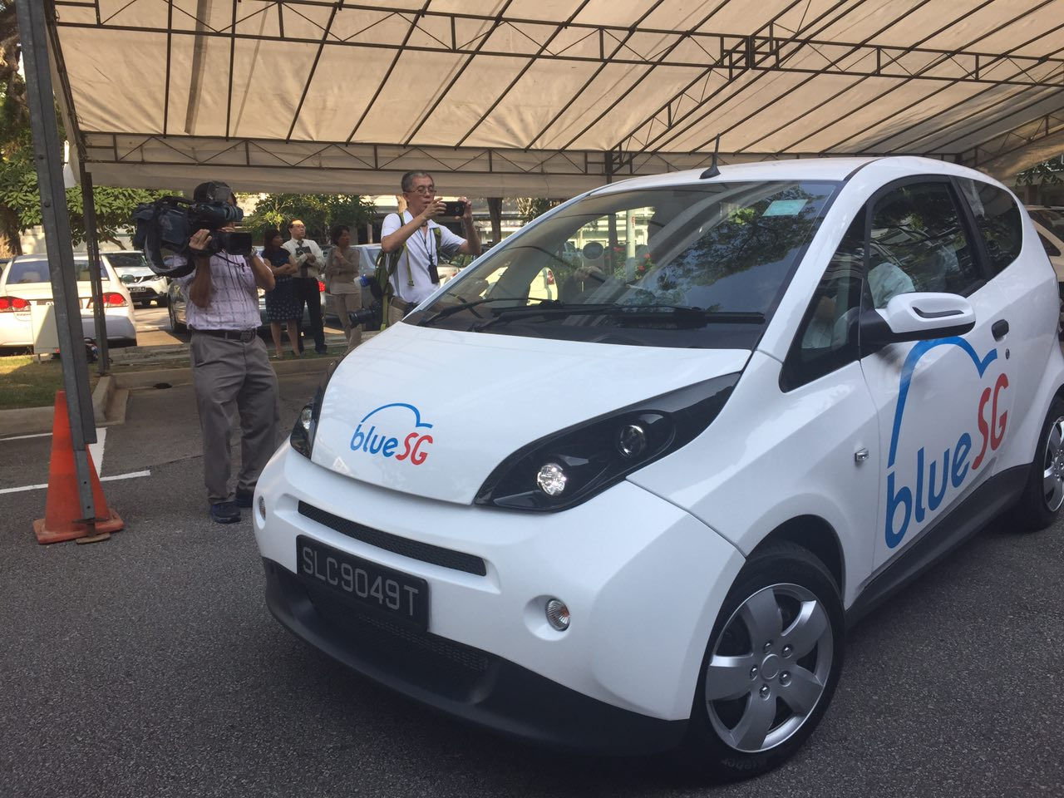
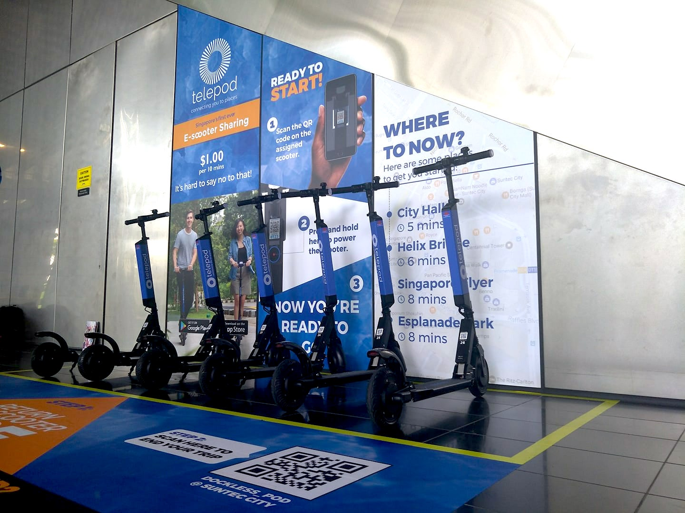
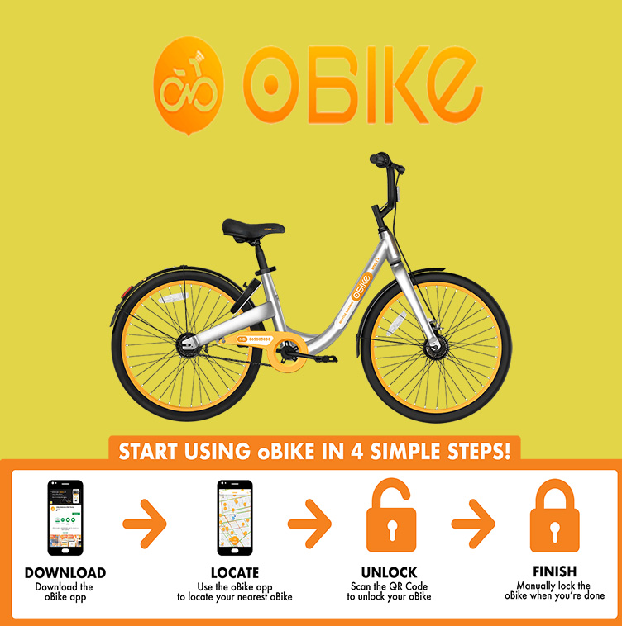
Literature Review
Sharing Economy
Peer-to-Peer (P2P)
Collaborative Consumption
In demands in the market
Notes:
Discuss about Blooming industry
P2P will continue to be heavily invested market (Use E&S topic to further justify what you mention) VUCA society
Knowledge based economy → Technology based economy

Slide 4

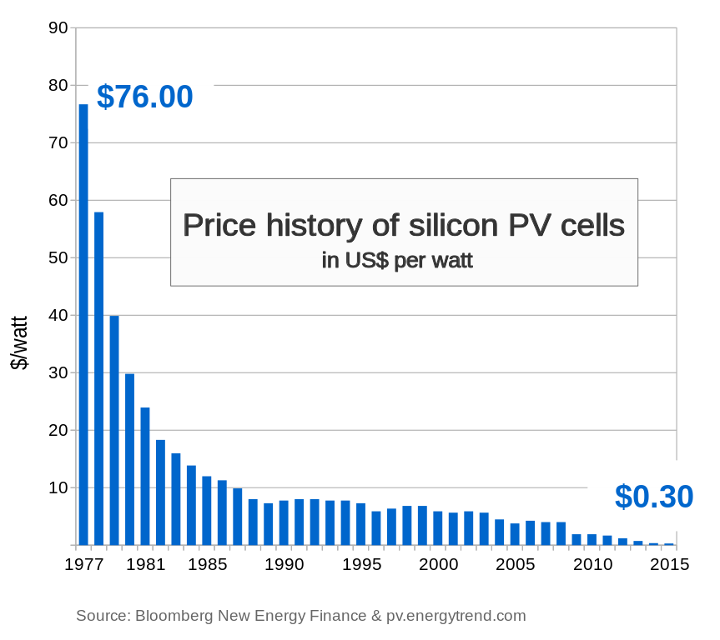
Motivation
Sustainability
Smart Nation
Growing Industry
Market Potential
$ 1.00

Slide 5
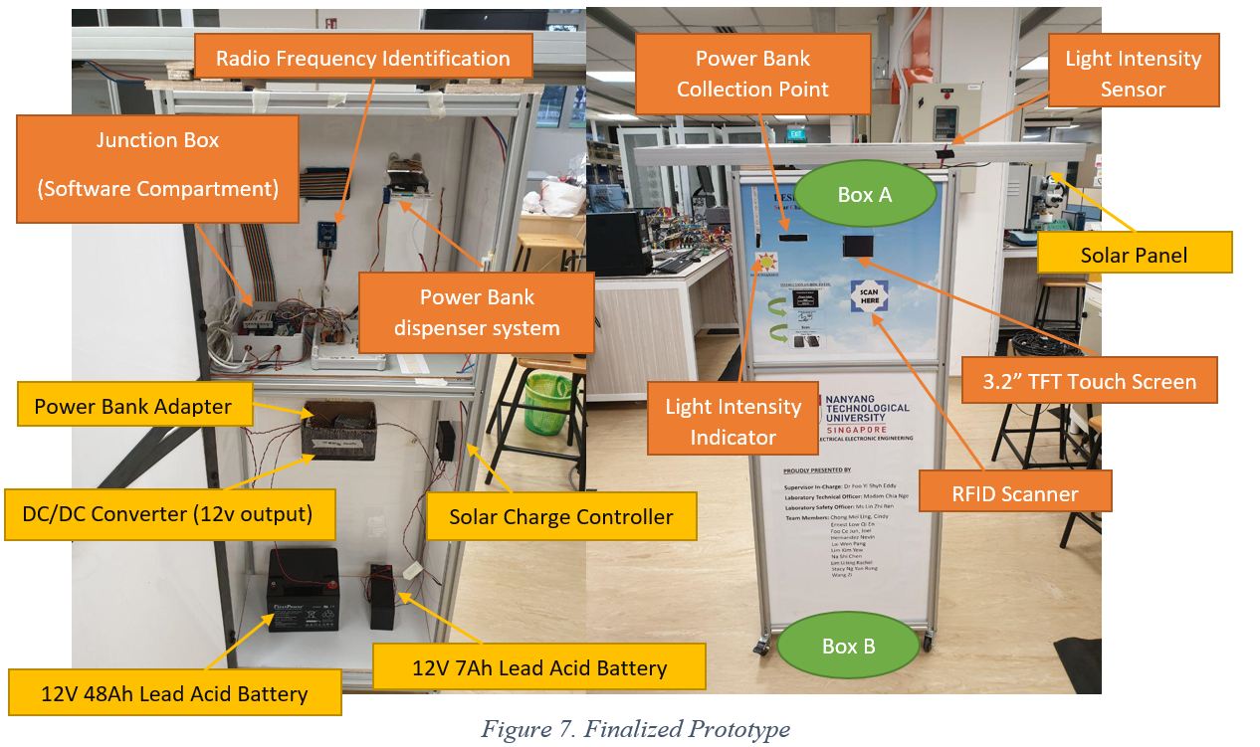
Prototype

Slide 6
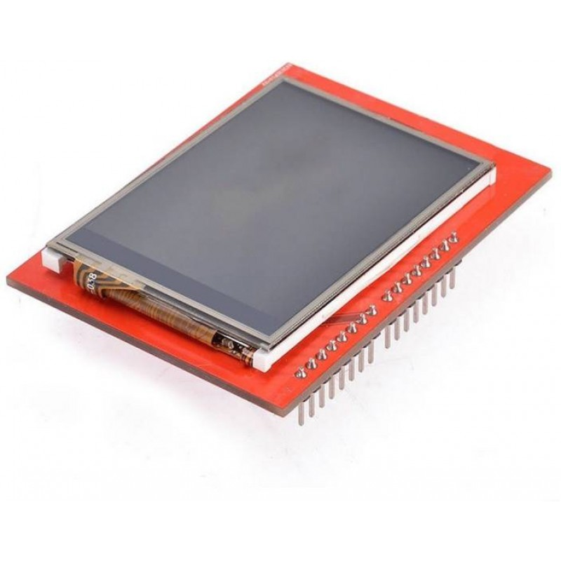
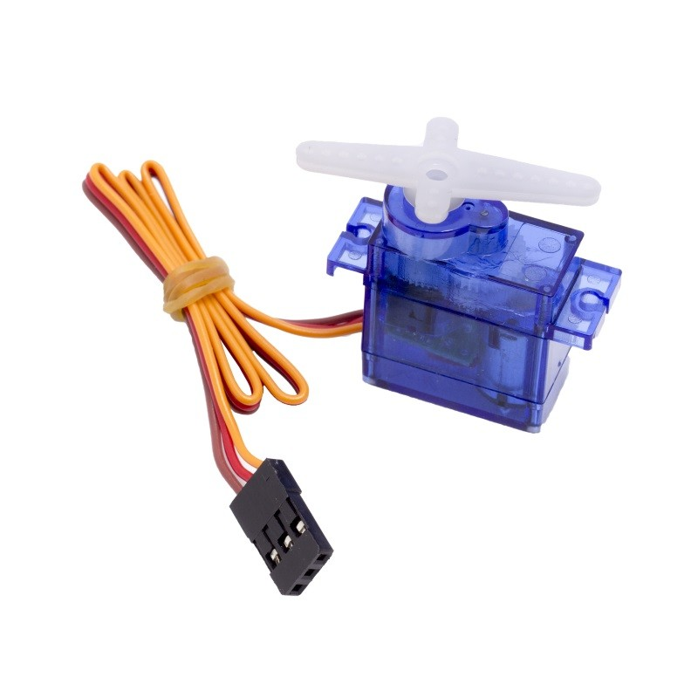
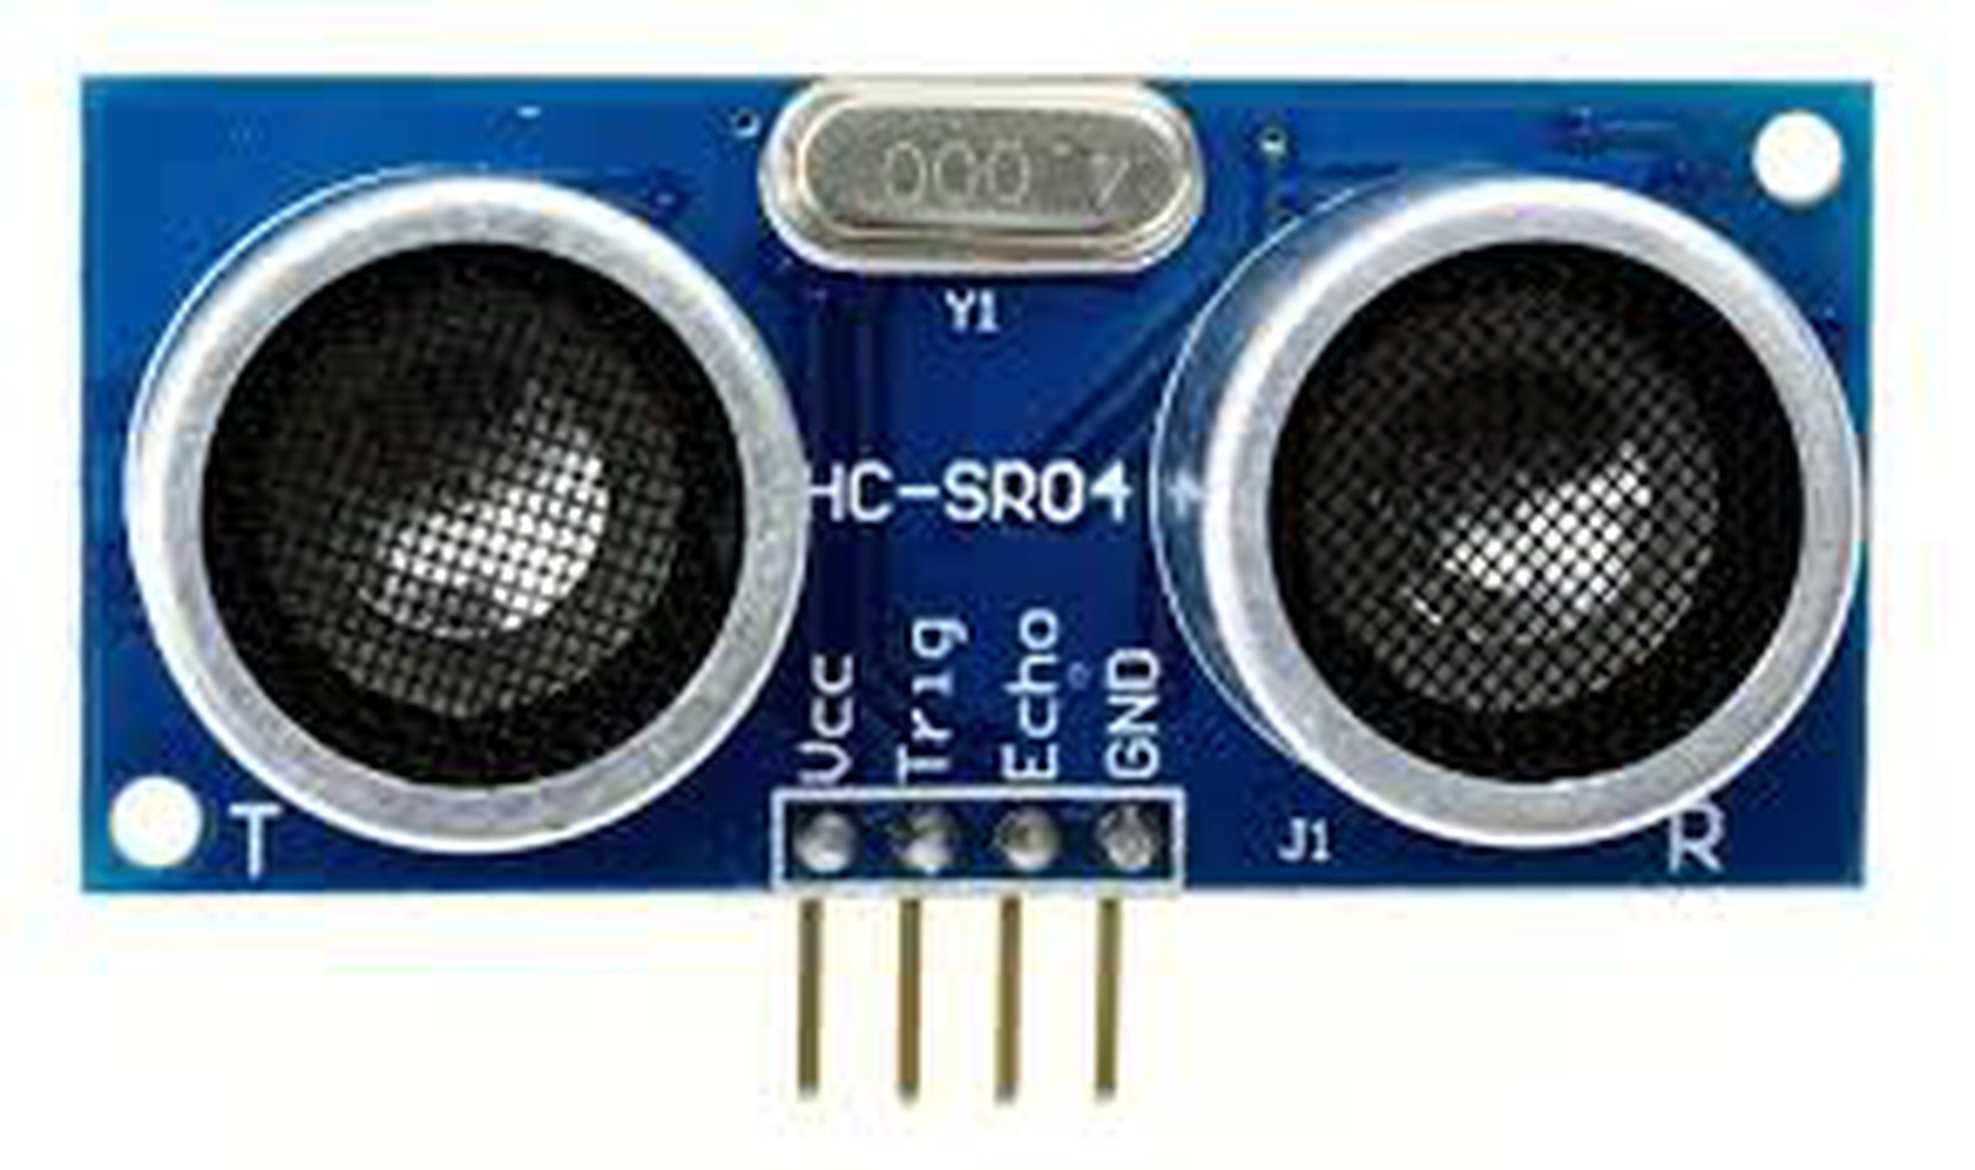
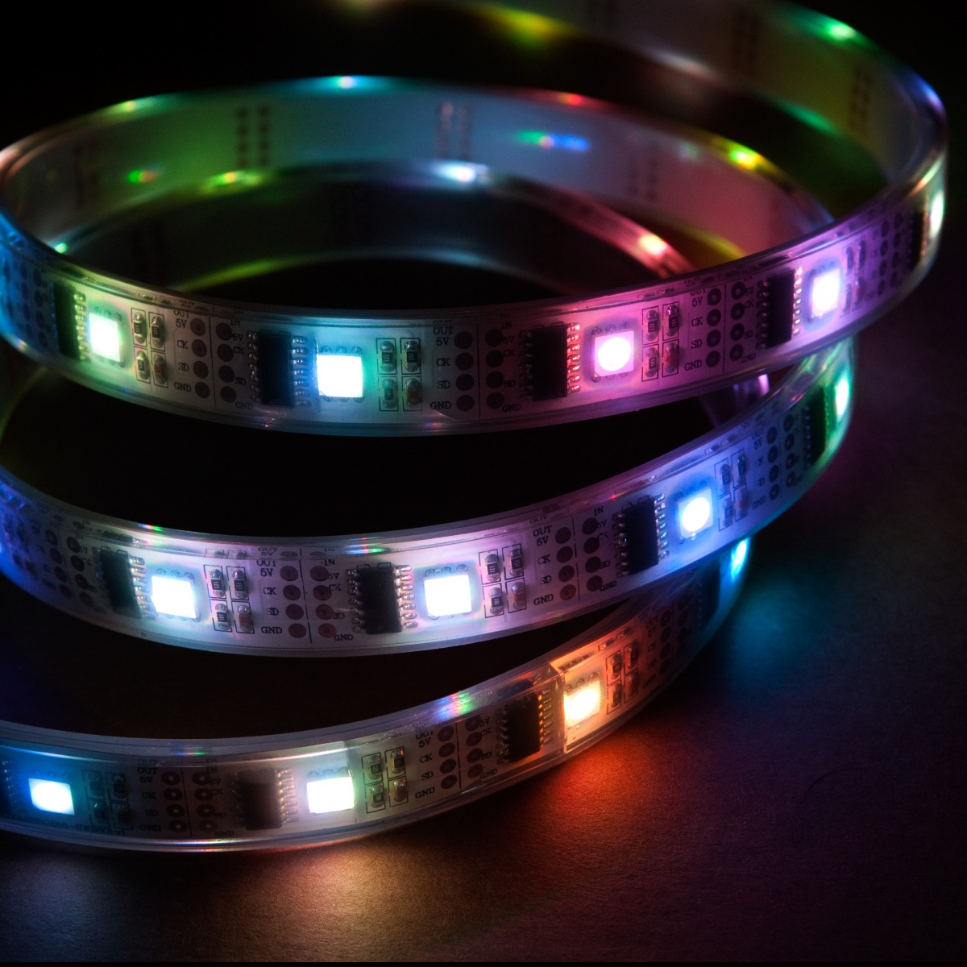
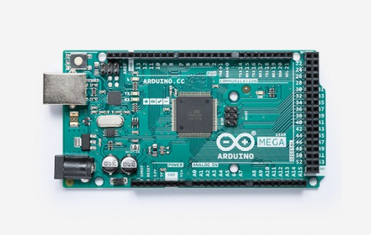
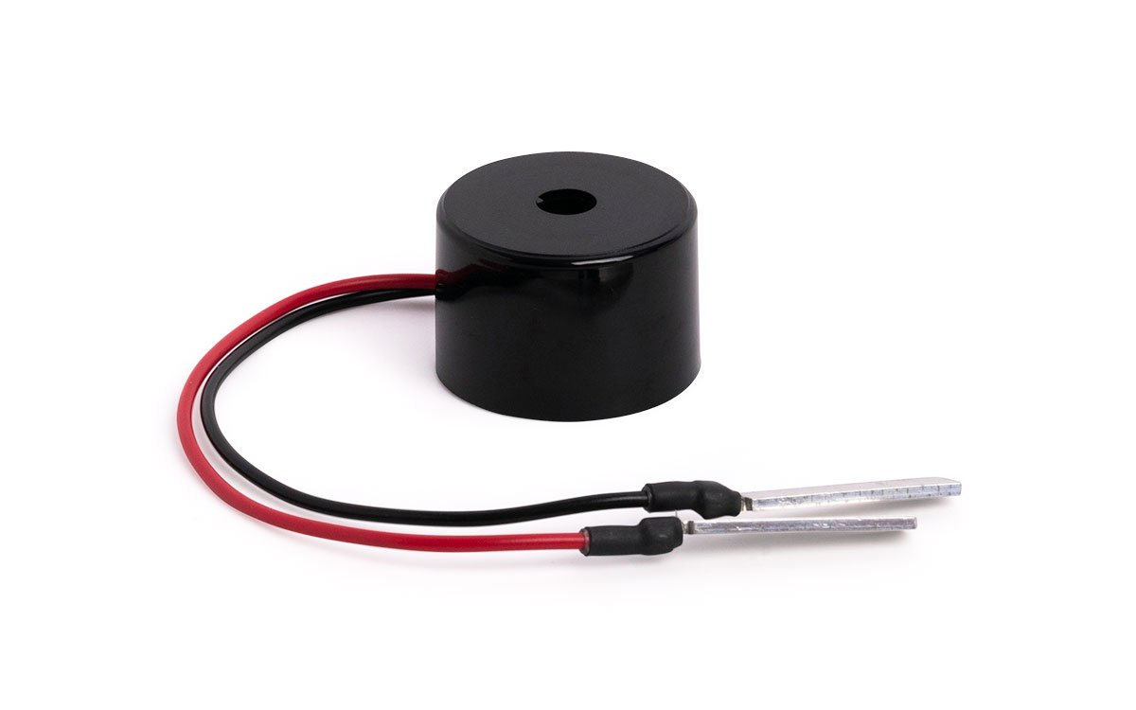
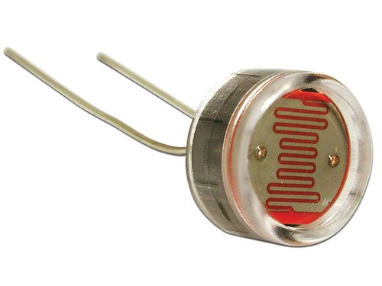
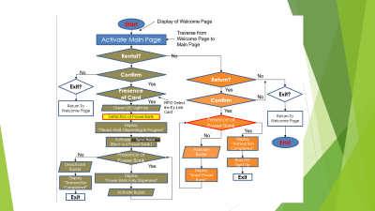
Overview
Graphical User Interface (GUI)
Back-End Operation
Analog Input
I2C
Universal Asynchronous Receiver-Transmitter (UART)
Analog Output
Arduino Mega 1
Arduino Mega 2
Notes:
Our prototype operate on 2 overarching principle:
Serial Communication
Redundancy system

Slide 7
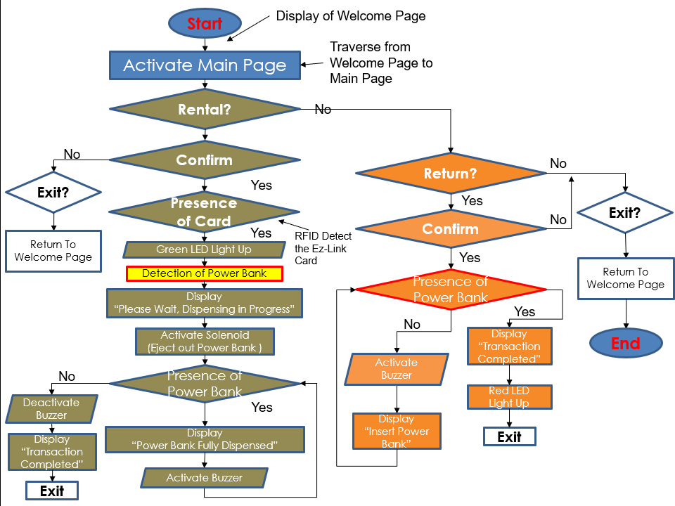
Servo Motor

Slide 8
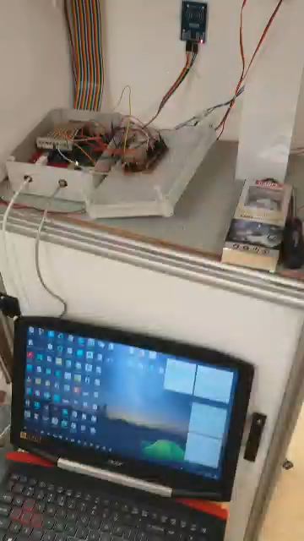
Rent

Slide 9
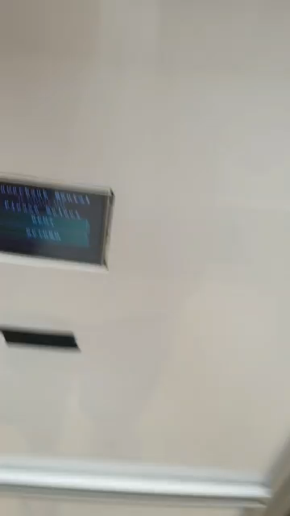
Return

Slide 10
Electrical Circuit Diagram
12V Charge Controller
12V DC/DC Converter
Positive Voltage Line
Negative Voltage Line
Diode
45Watts
Solar PV
Arduino Mega 1 & 2
Diode
Power Bank Adapter
Power Bank
Lead Acid Battery
12v 7Ah
Lead Acid Battery
12v 48Ah

Slide 11
System Operation
Mode of Operation | Voltage | Current | Power | Lifetime (w/55Ah)
Normal Operation (W/active power bank charging | 12Volts | 0.517A (0.327+0.19) | 6.2W | 106.38 hours (4.4days)
Active Operation | 12Volts | 0.96A | 11.52W | 57.29 hours (2.38 days)
System Runtime
Redundancy action
Cost figures
Expenditure | $835.75
Project Cost | Software | Hardware | Est Panel
 | $298.05 | $347.6 | $105.91
 | $751.56
Notes:
Do include the system operation condition, etc. the current needed / Voltage needed,
To aid in explaining the first point.
Use the electrical diagram to explain the second point on the redundancy action.

Slide 12
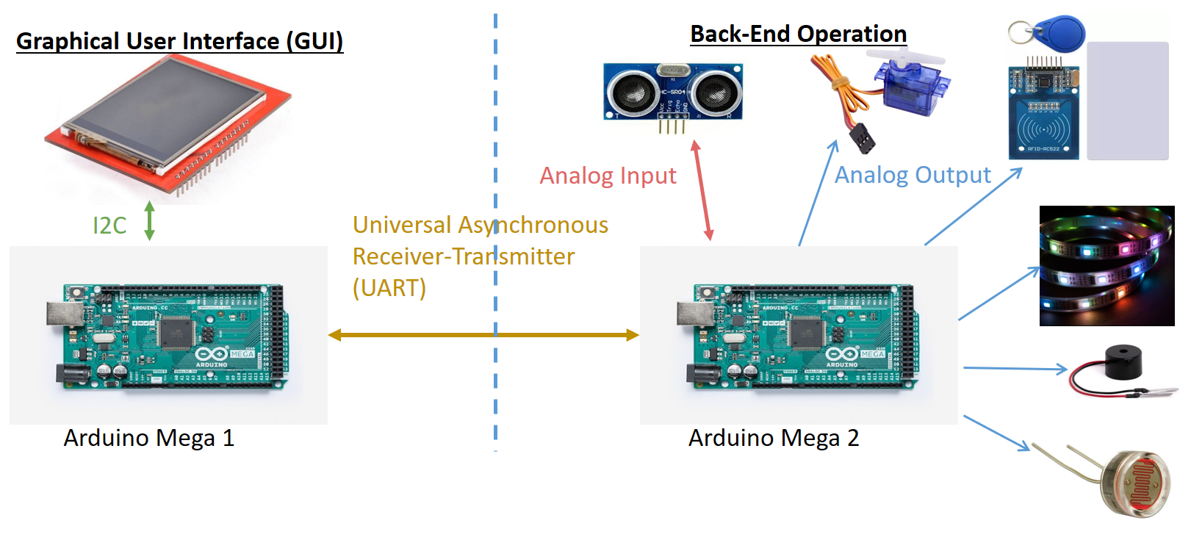
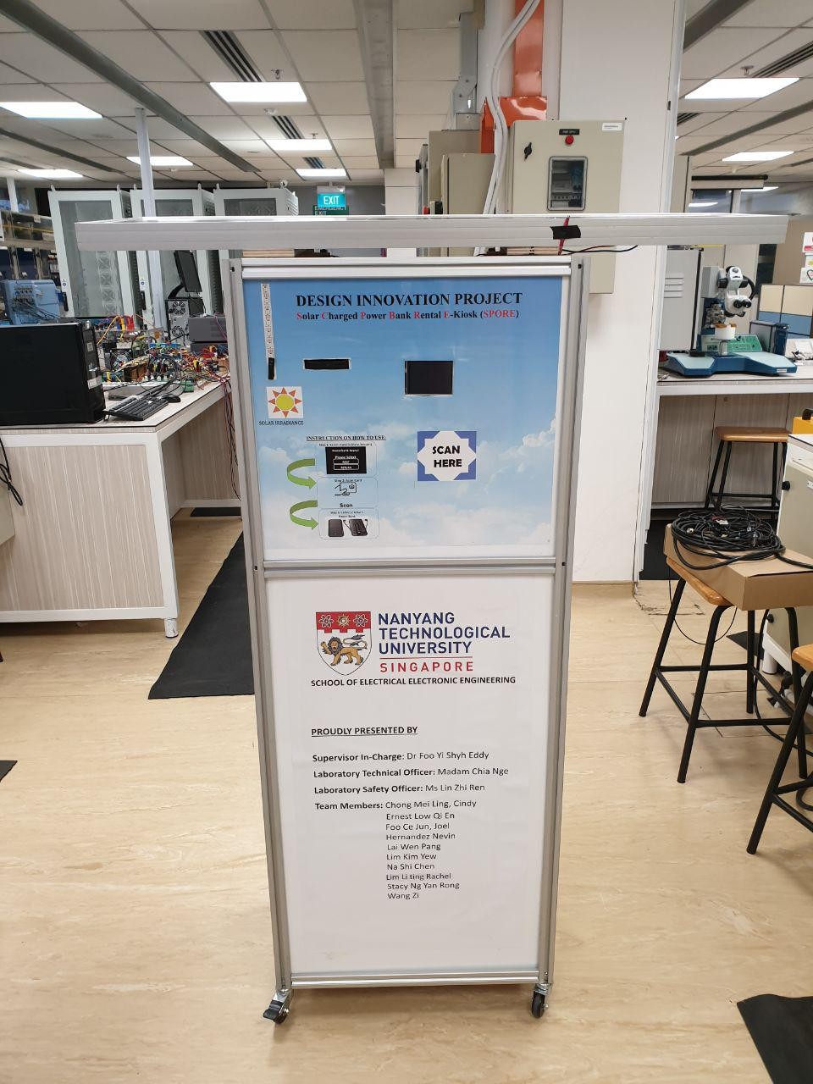
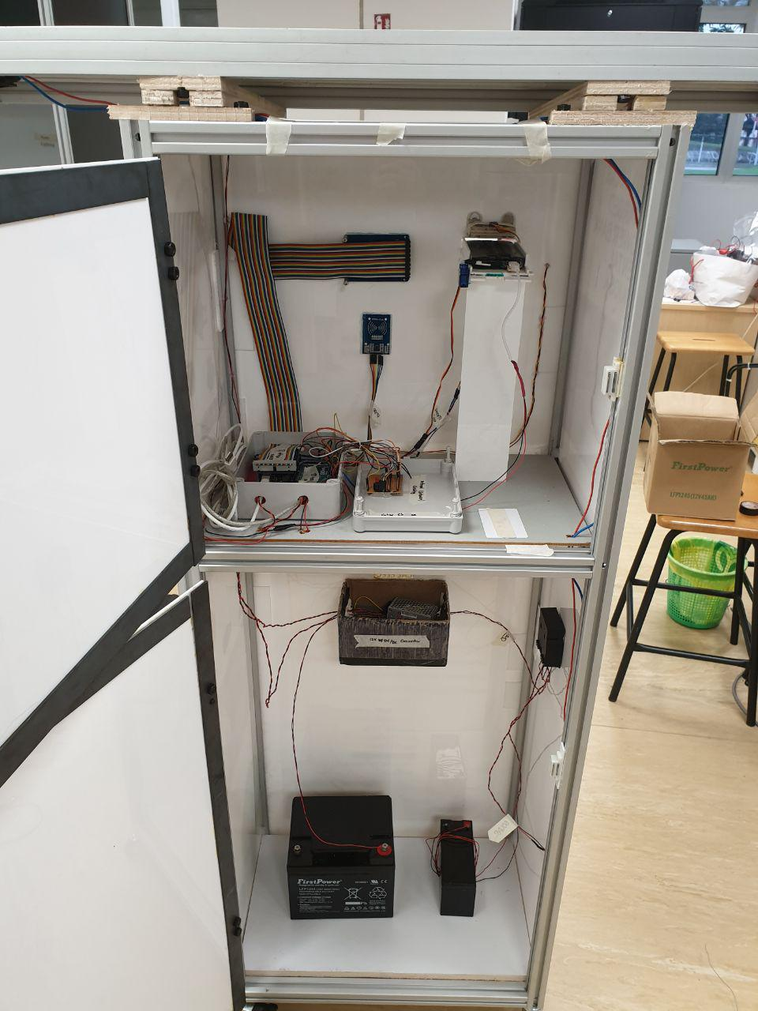
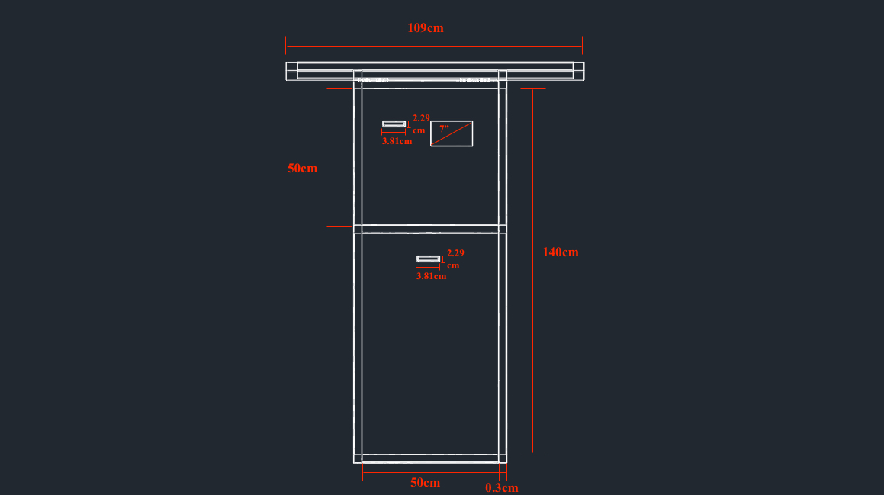
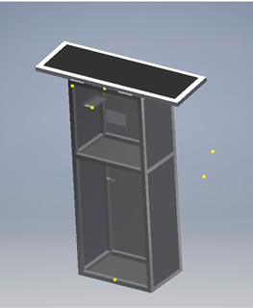
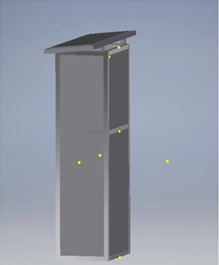
Critical Challenges
Prototype design consideration (Hardware design)
Material
Dimension
System design
Software
Electrical
Integration
Reliability & Functionality
Notes:
Go and edit this slide further

Slide 13

Infinite Possibilities
Battery Management System
Redundancy Electrical System
Network Hub (Machine to Machine over cloud)
Business Model (Diversify our sharing system)**
Block Chain Technology Enhancement
Sustainable Cloud Network system for M2M
“Make an impact through this small action and it will accumulate into an great achievement once you walk finished one loop around the earth.”
Notes:
What does it mean by diversify?
To create a skeleton structure of a sharing market and allow other business model to integrate in it. Doing what an engineer do best.

Slide 14
Question & Answer

